Slide 1
















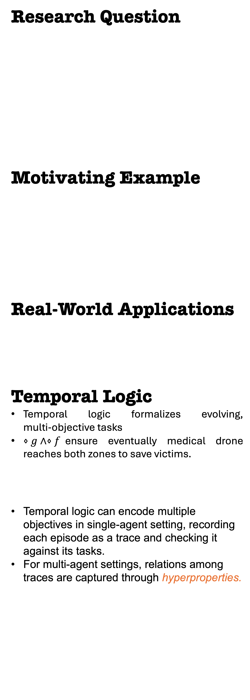
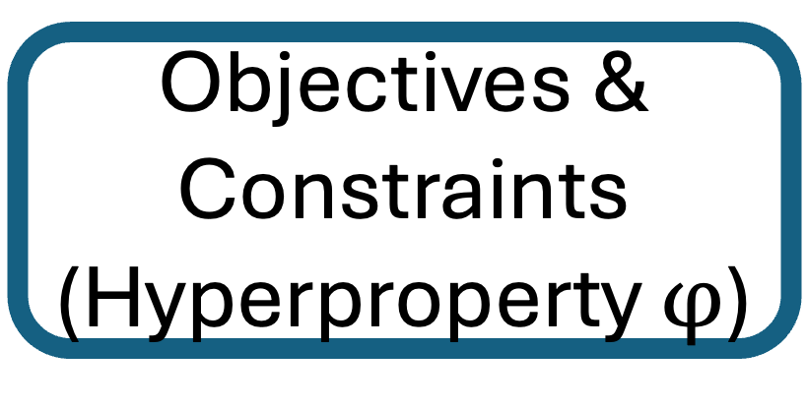
Research Question
Motivating Example
Real-World Applications
Temporal Logic
Temporal logic formalizes evolving, multi‐objective tasks
$⋄g∧⋄f$ensure eventually medical drone reaches both zones to save victims.
Temporal logic can encode multiple objectives in single-agent setting, recording each episode as a trace and checking it against its tasks.
For multi‑agent settings, relations among traces are captured through hyperproperties.
HypRL:
Reinforcement Learning
of Control Policies for Hyperproperties
Tzu-Han Hsu*, Arshia Rafieioskouei*, Borzoo Bonakdarpour
TART LAB, Michigan State University
Paper
Multi-Objective
Multi-Agent
What are Hyperproperties?
Hyperproperties characterize requirements over sets of execution traces, allowing the specification of behaviors that involve multiple agents.
HyperLTL formula that captures all objectives and constraints of the example.
Challenges
The Quantifier Alternation introduce interaction between multiple traces.
Skolemization technique
Transform logical property to valued reward function
A Robustness Function assigns a robustness value to a trace for a temporal logic formula.
HypRL
How efficient is HypRL?
Safe RL
PCP
Take Aways!
Hyperproperties capture objectives and constraints for multi‑agent RL.
HypRL turns any HyperLTL spec into a reward function .
HypRL outperforms baseline rewards functions.
How to Shape
Optimal Reward Functions?
g | h | i
d | e | f
a | b | c
Ext Fire: +50 Rescue Victim: +10
Out of range: -100 Med in Fire: -100
path: a – b – c – f – i
path: a – d – a – d –j – h – e – f
Optimal Path:
path: a – d – e – f – i
path: a – d – a – d –j – h – e – f
Env
Next episode&
Rewards
Agents
Optimal Policies
MDP
States
a
d
g
h
e
f
Robustness Function
Skolem($φ$)
Samples
Objectives & Constraints
(Hyperproperty $φ$)

